Slide 1
Wireless Communications:
Principles and Practice
2nd Edition
T.S. Rappaport
Chapter 9: Multiple Access Techniques for Wireless Communications

Slide 2
Capacity and Multiple Access Issues

Slide 3
3G & 4G:
The Future of Wireless

Slide 4
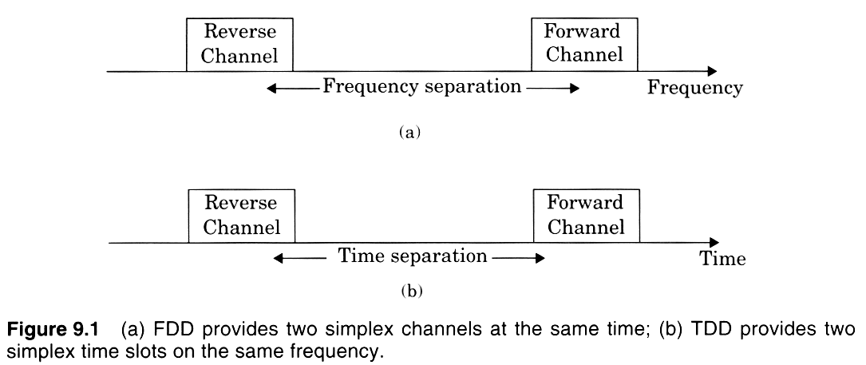

Slide 5
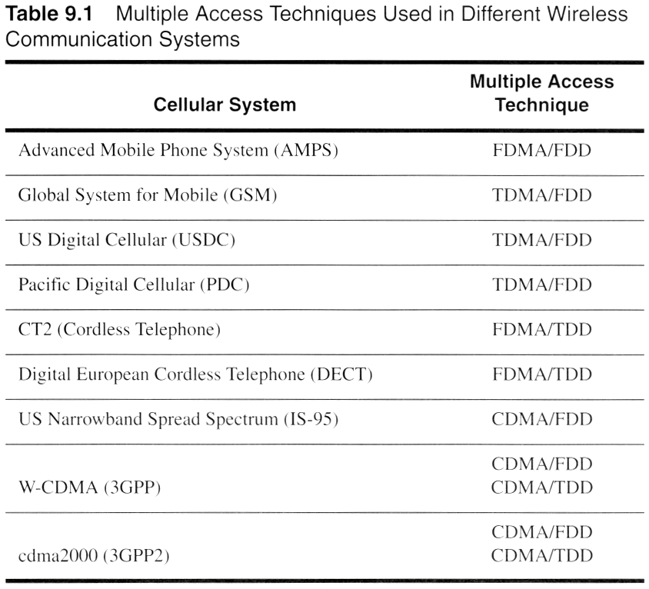
Notes:
Fig. 2.11

Slide 6
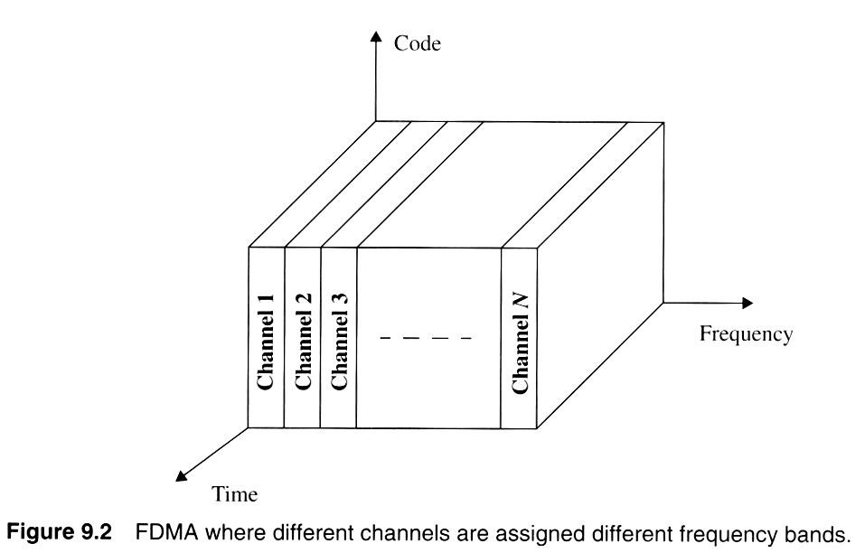
Notes:
Fig. 3.2

Slide 7
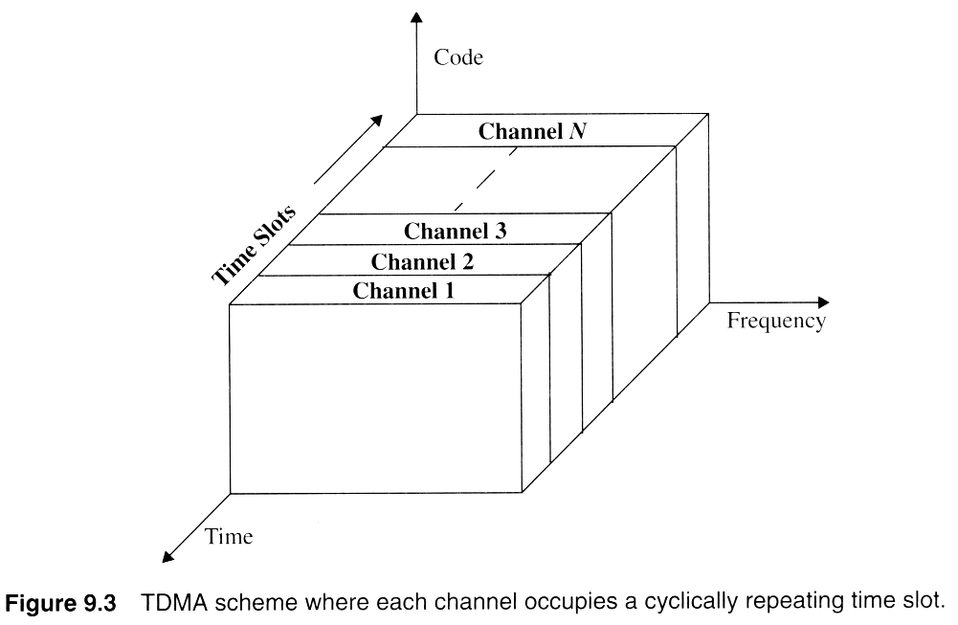

Slide 8
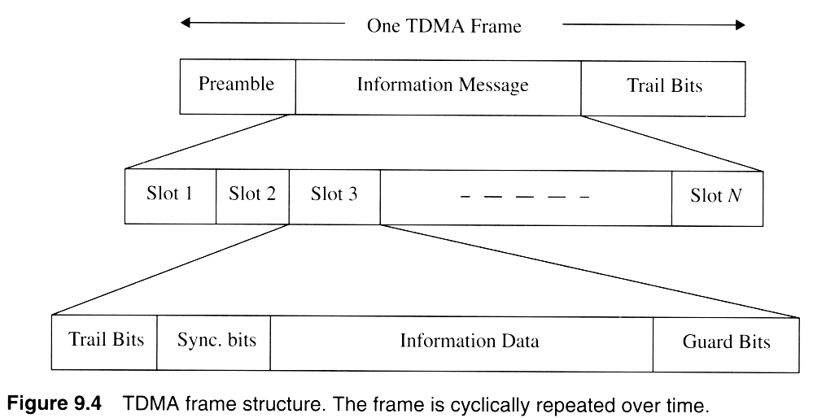
Notes:
Fig. 2.3

Slide 9
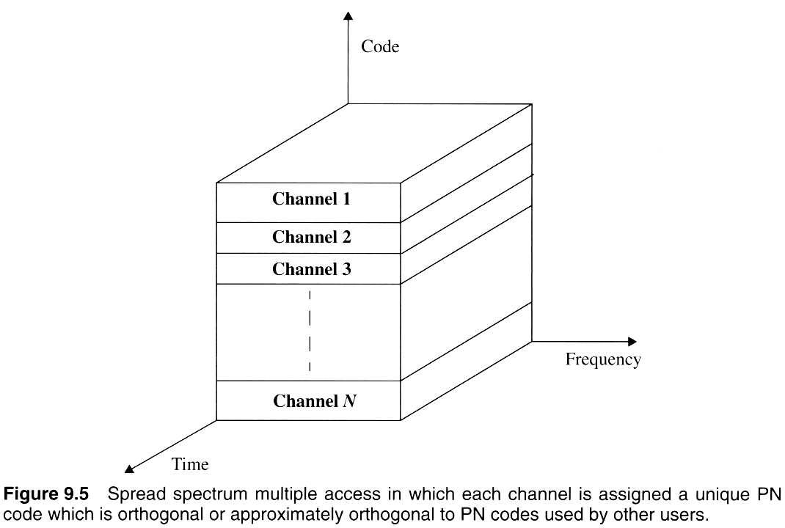

Slide 10
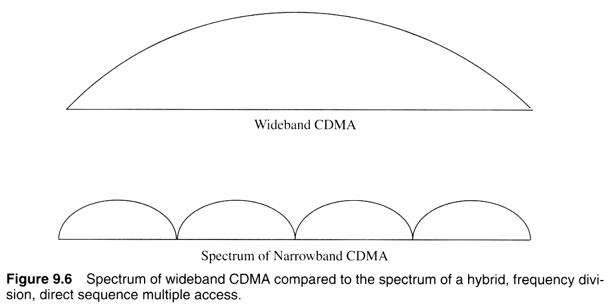

Slide 11
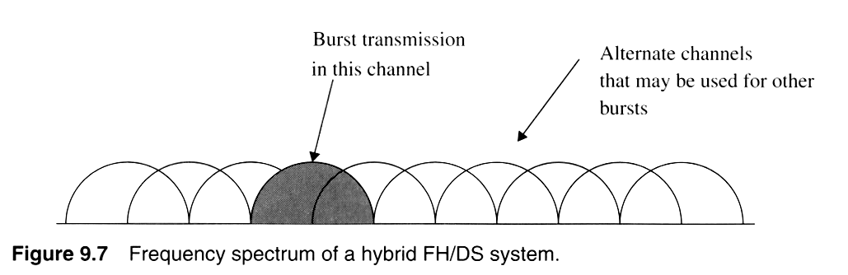
Notes:
Fig. 2.4

Slide 12
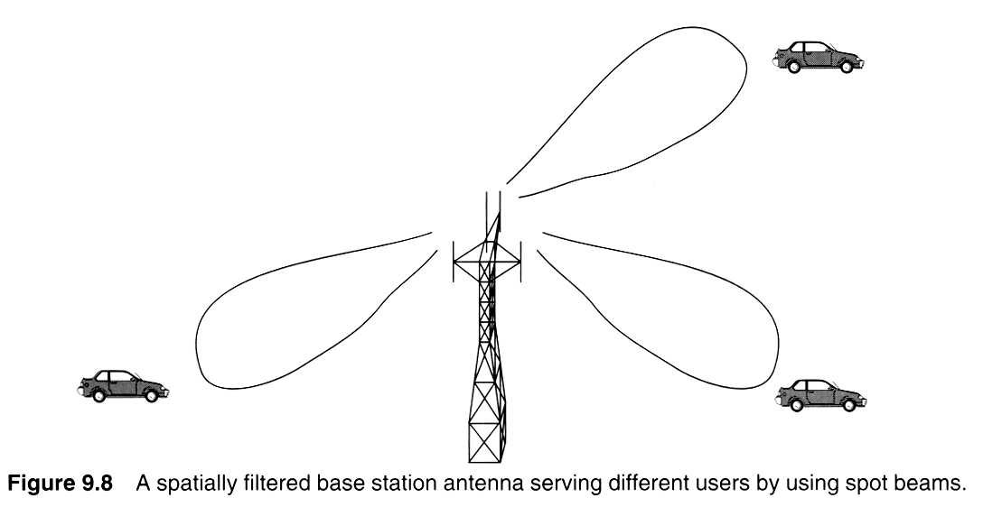
Notes:
Fig. 2.5

Slide 13
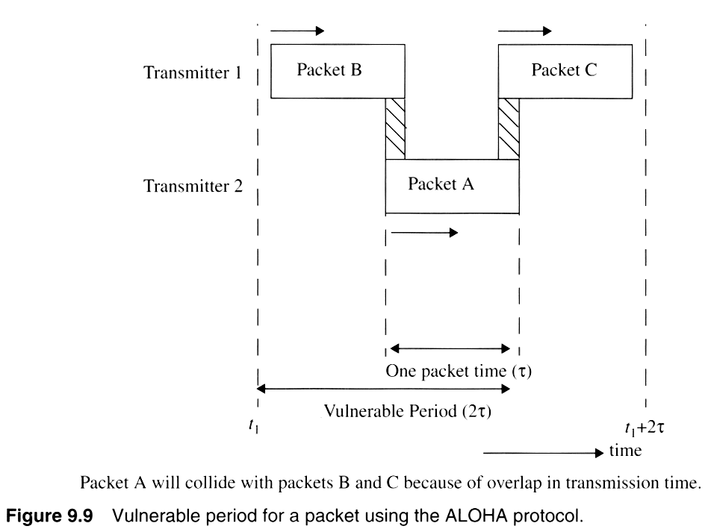
Notes:
Fig. 2.5

Slide 14
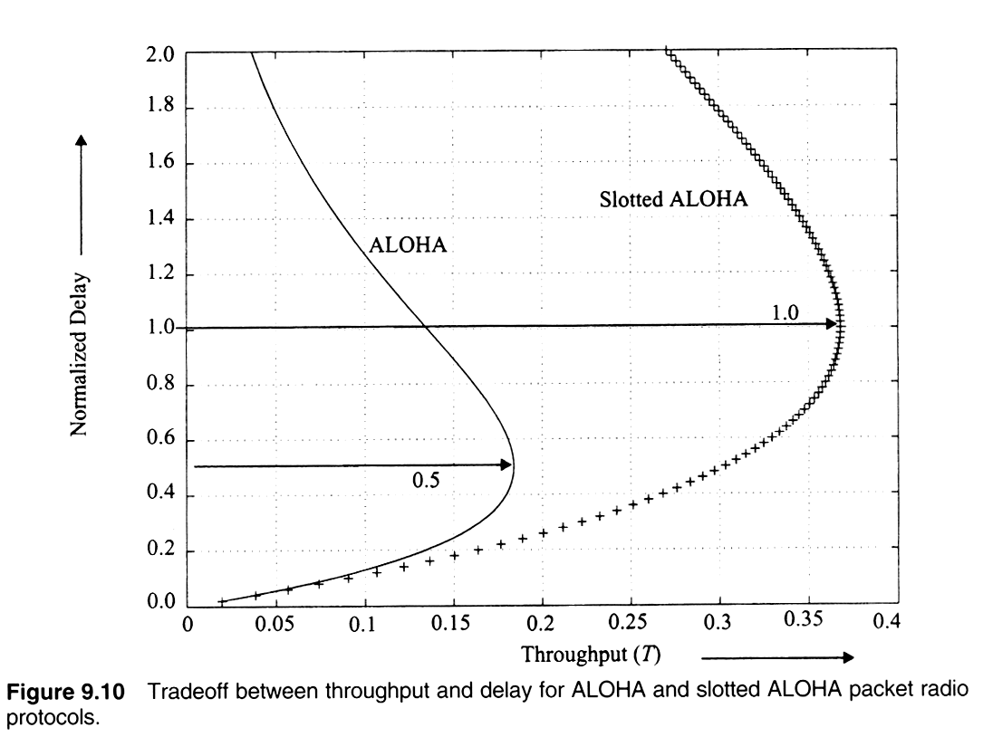
Notes:
Fig. 2.6

Slide 15
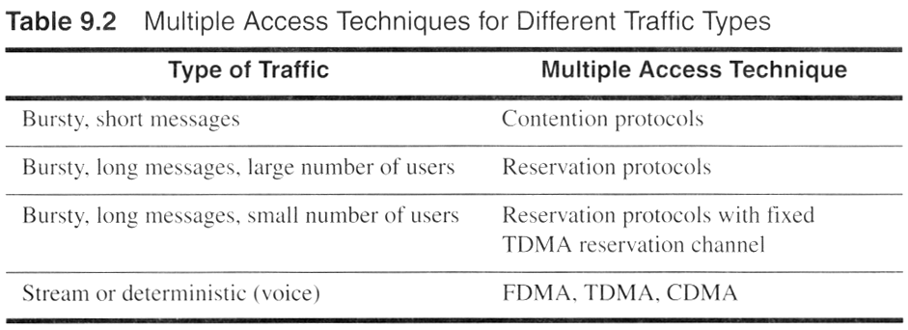
Notes:
Fig. 2.11

Slide 16
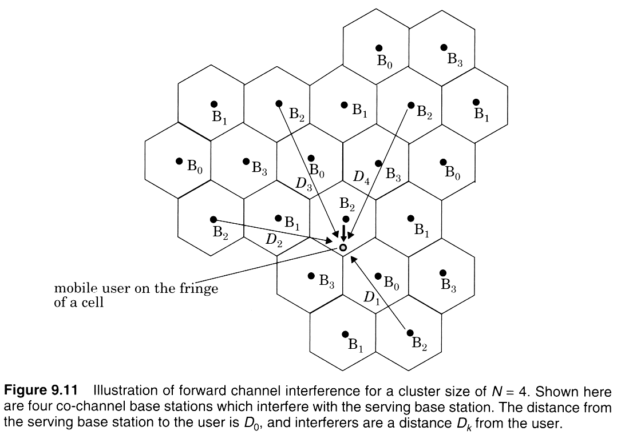
Notes:
Fig. 2.9

Slide 17
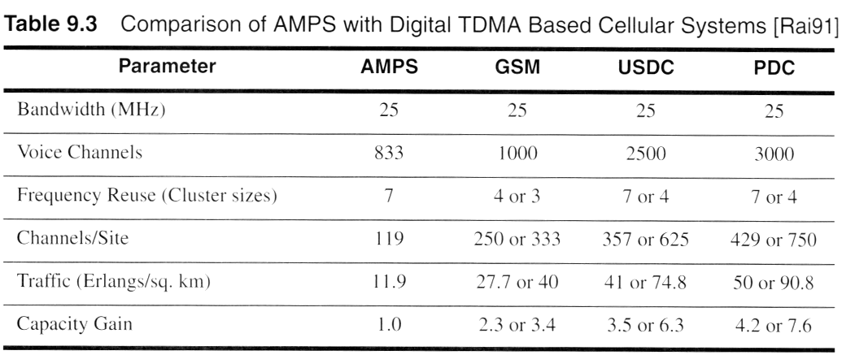
Notes:
Fig. 2.11

Slide 18
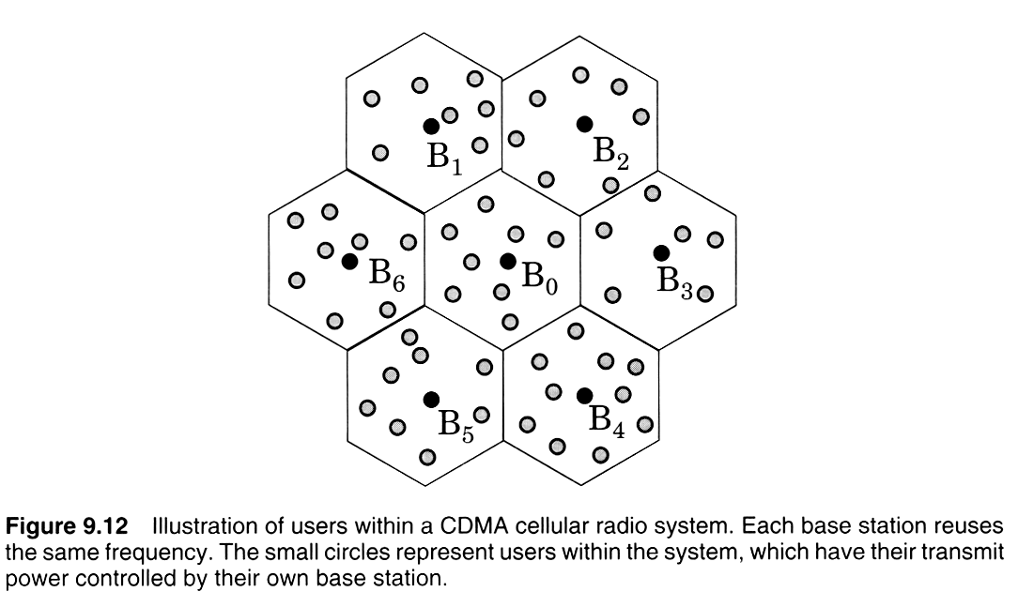
Notes:
Fig. 2.7

Slide 19
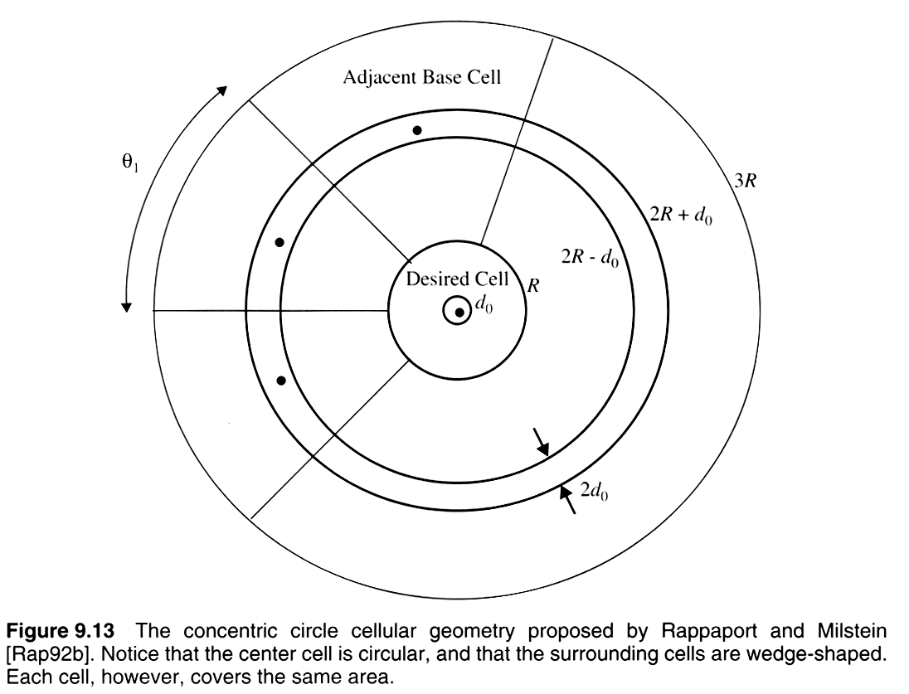
Notes:
Fig. 2.16

Slide 20
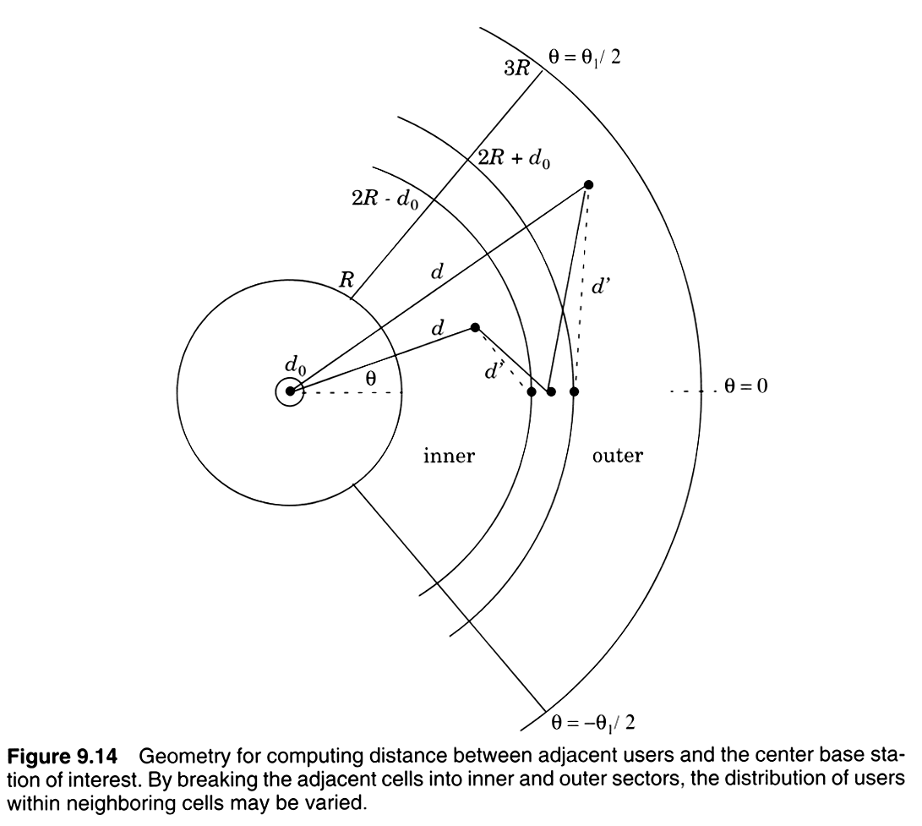
Notes:
Fig. 2.8

Slide 21
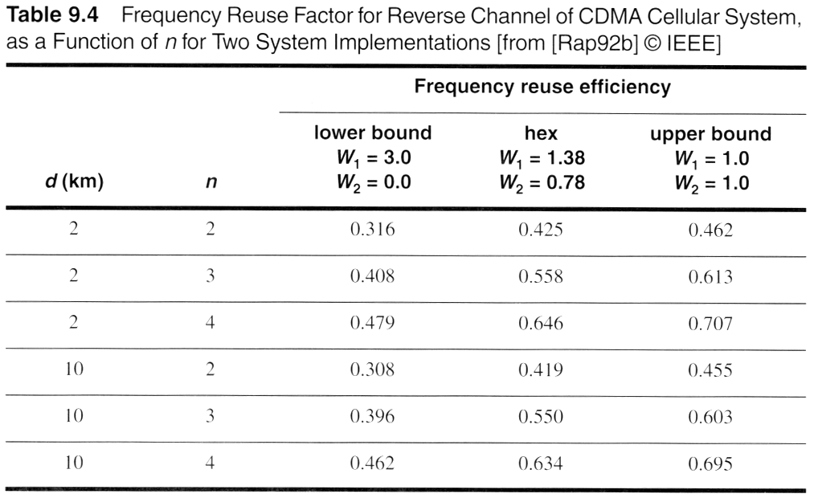
Notes:
Fig. 2.11

Slide 22
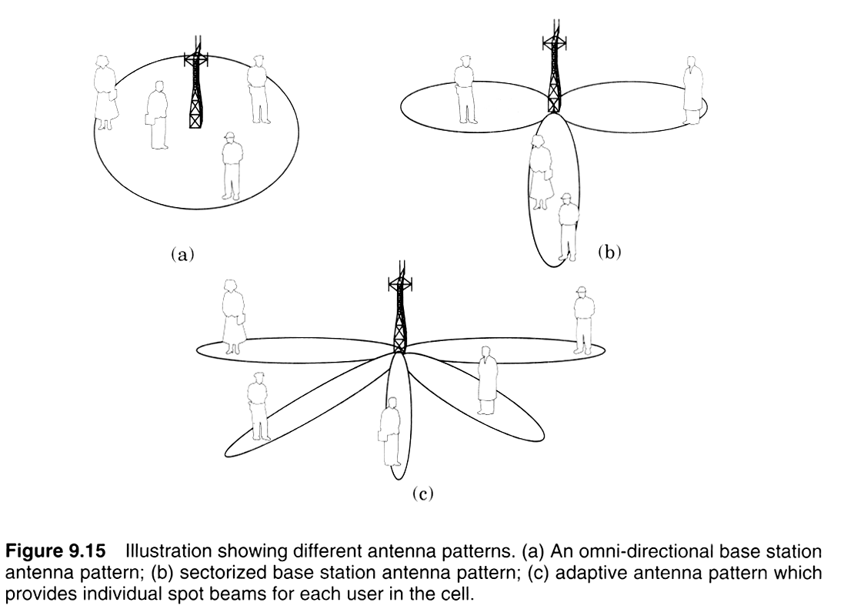
Notes:
Fig. 2.10

Slide 23
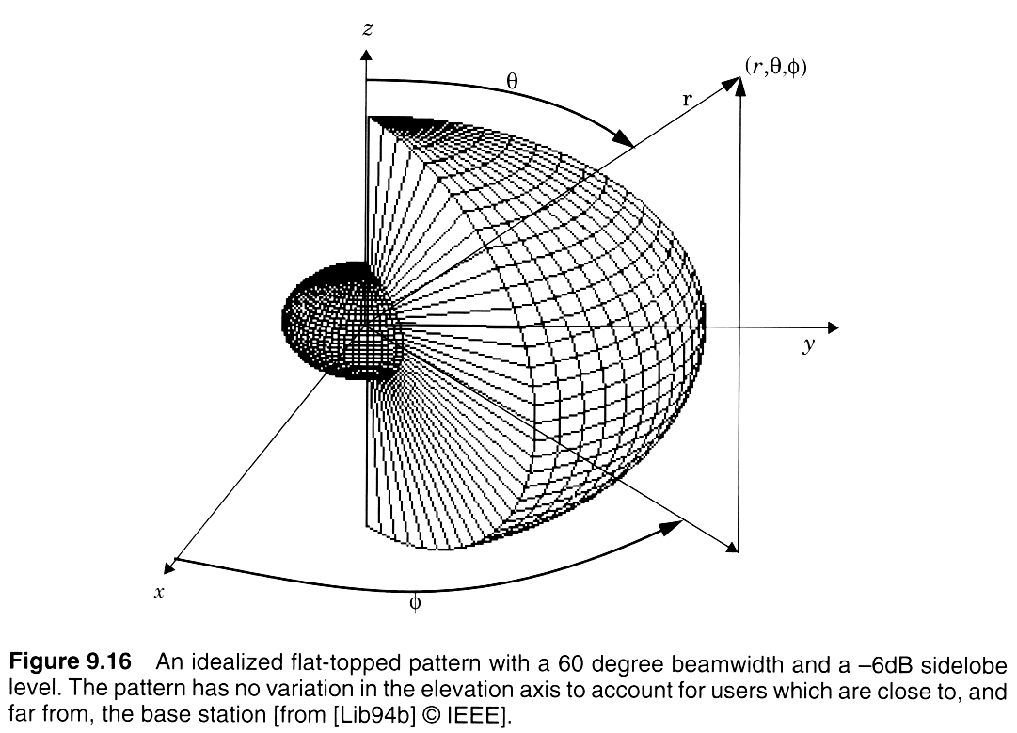
Notes:
Fig. 2.11

Slide 24
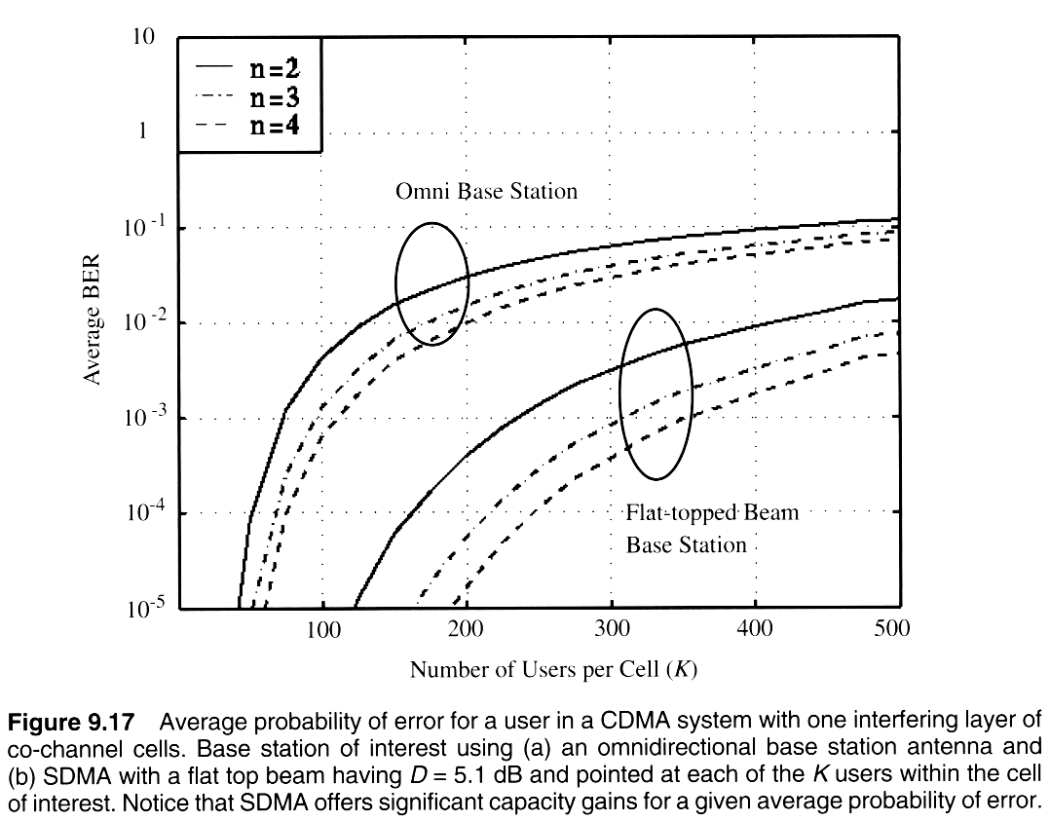
Notes:
Fig. 2.11

